Slide 1
Active Supervision
Non-Classroom Applications

Slide 2
What Is Active Supervision?
Active supervision is a proactive approach used in school settings to monitor a large area in order to ensure safety and reduce problem behaviors from occurring.
It is most commonly used in non-classroom settings such as the cafeteria or playground since these types of settings often have less adult direction and supervision.
By scanning and moving around the area while interacting with the students, staff members support and reinforce appropriate behavior and correct inappropriate behavior.

Slide 3
What Are the Features of Active Supervision?
Movement
Scanning
Positive Contact
Positive Reinforcement
Instructional Responses
Immediate and Contingent Delivery of Aversive Consequences
Team Directed Data-Based Decision Making and Intervention Implementation

Slide 4
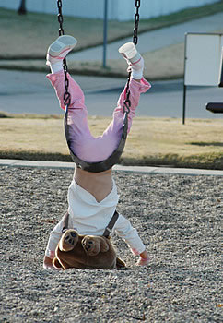
Movement
Constant movement tends to give students the impression you are everywhere.
Movement should be random and unpatterned.
Movement should target known problem areas, activities, and individuals.

Slide 5
Scanning
Maintain constant visual movement
Look at students’ behaviors not just the games, clothes, etc.
Identify and pay attention to behaviors the precede misbehavior—games breaking up for no reason, angry gesturing, scared looks, someone running away from a group.
Listen for behavior—angry voices, whining, panicked voices, authoritative commands
Focus on as many different areas as you can.
Recognize potential trouble spots and scan them often.
Minimize time spent dealing with problems— “Two-Minute Rule”

Slide 6
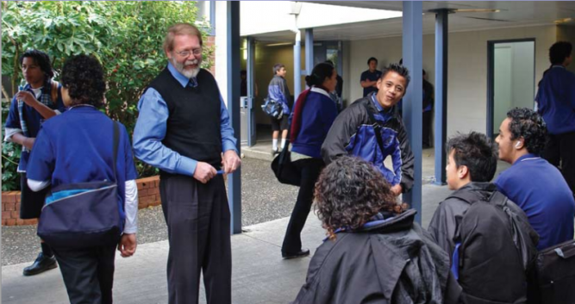
Positive Contact
Not the same as positive reinforcement
Friendly, helpful, open demeanor
Proactive, non-contingent
High rate of delivery
Goal is to build relationships

Slide 7
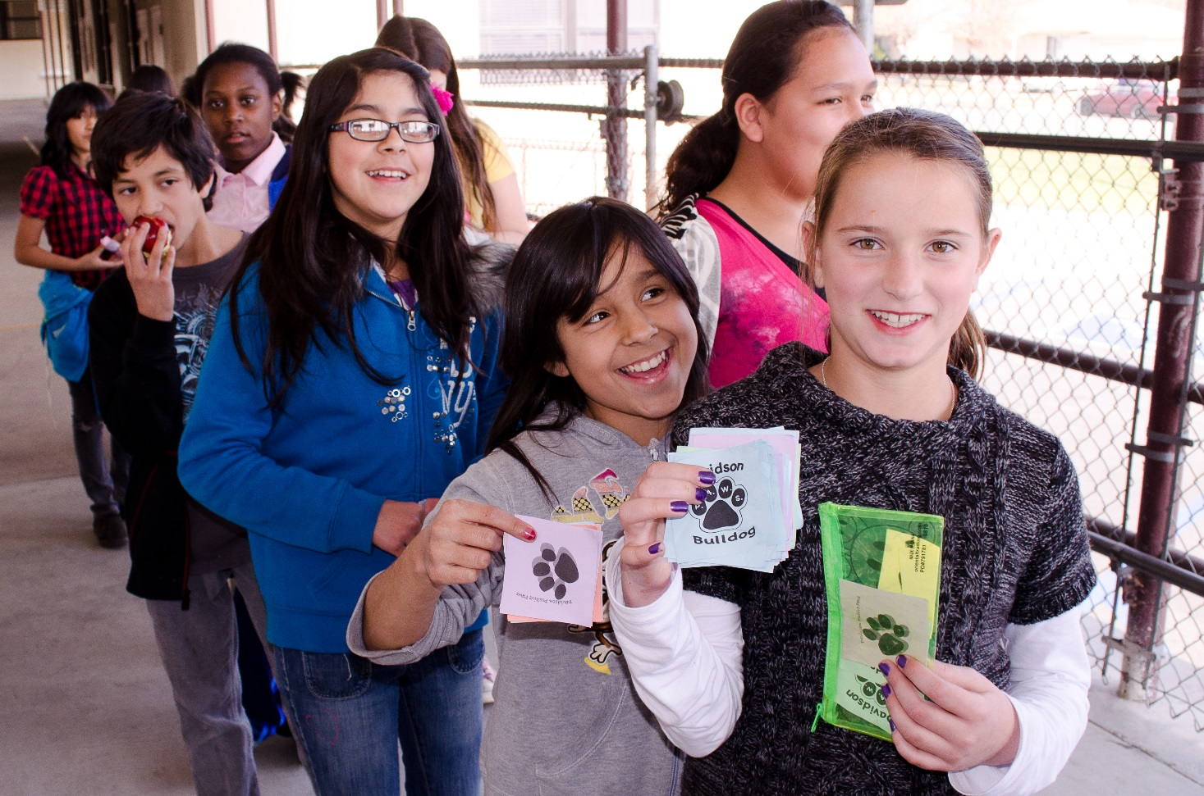
Positive Reinforcement
Immediate
Contingent on behavior
Consistent
High rate
Goal is to change behavior

Slide 8
Instructional Responses
Systematic
  Pre-correction—reminding, prompting
  Correction—define the behavior students must exhibit
  Model—demonstrate the expected behavior
  Practice—ask them to show you the appropriate behavior
  Test—watch for correct usage next time and acknowledge
  Reteach—some students require more than one exposure to the skill
Immediate
Contingent on behavior
Nonpersonal, calm tone of voice
Specific to behavior
Consistent across staff

Slide 9
Immediate and Contingent Delivery of Consequences
Characteristics
Process
Neutral, business-like demeanor
Non-argumentative, non-critical
Consistent
Fair, non-arbitrary
Take the student aside.
Review what you saw.
Ask the student state the expected behavior. If they can’t or won’t, then state the expected behavior.
Give student choices for correcting the problem behavior.
Explain the school-prescribed consequence.
Apply the consequence immediately or as soon as possible.

Slide 10
Immediate and Contingent Delivery of Consequences
Process
Two-Minute Rule
PROBLEM BEHAVIOR OCCURS
Supervisor defines problem and gives the student a direction, a correction, and/or consequence.
Student is Compliant
Supervisor acknowledges cooperation (thanks or praise).
Student is Noncompliant
Supervisor redirects and gives student choices for compliance.
If you cannot correct a problem behavior within one or two minutes, the student should be referred to another setting or staff member for processing.

Slide 11
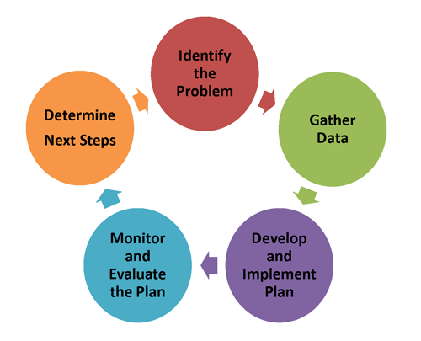
Team Directed Data-Based Decision Making
Administrative buy-in and support
Meet regularly
When? Where? Who? What? Why?

